Slide 1

Travel App with National Park API and To-do list
Rolando Banasco Cuellar, Danich Hang, George Maged Samir Aziz

Slide 2
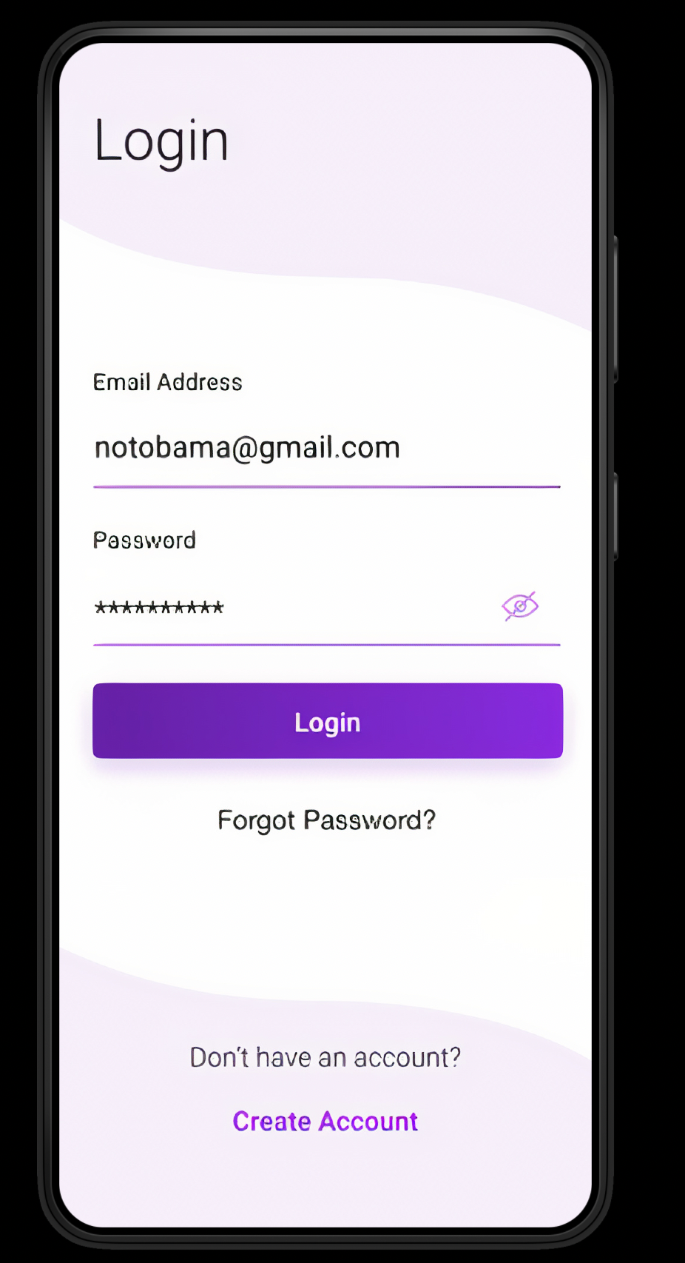
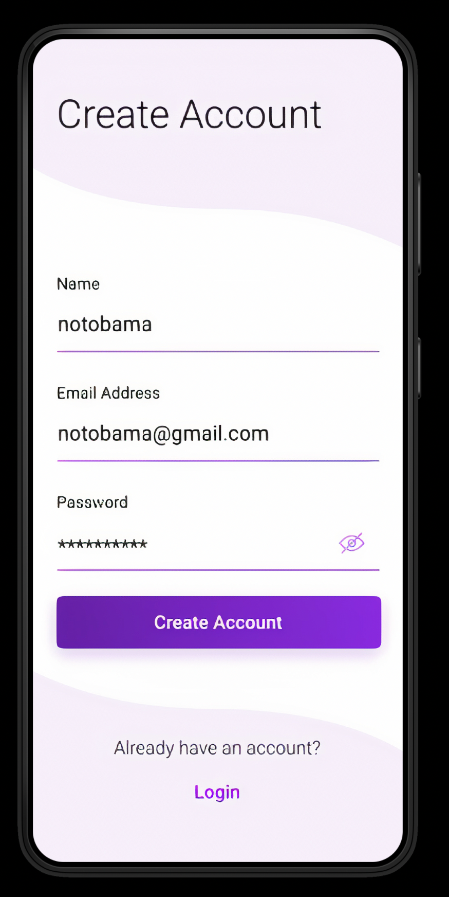
Home Page User Login | Register
First Page Users get greeted by will be a Login | Register page in which they will have to input their information to have access to the App.

Slide 3
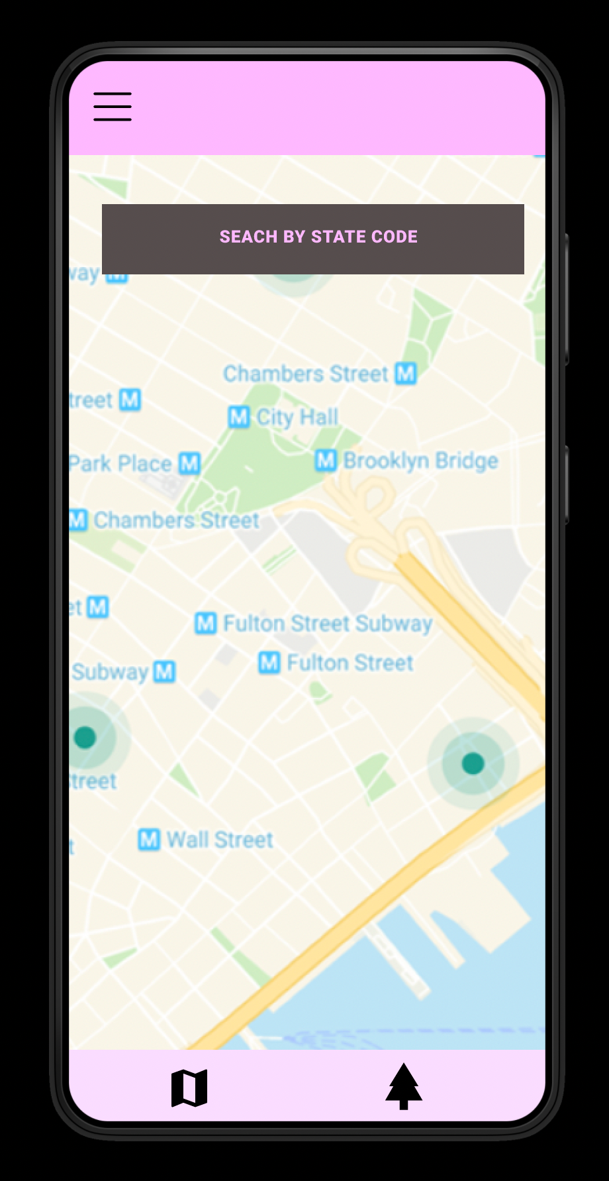
Landing Page: - Users will be able to search parks by state code -Map of the United States of America with locations of national parks showed by API.

Slide 4
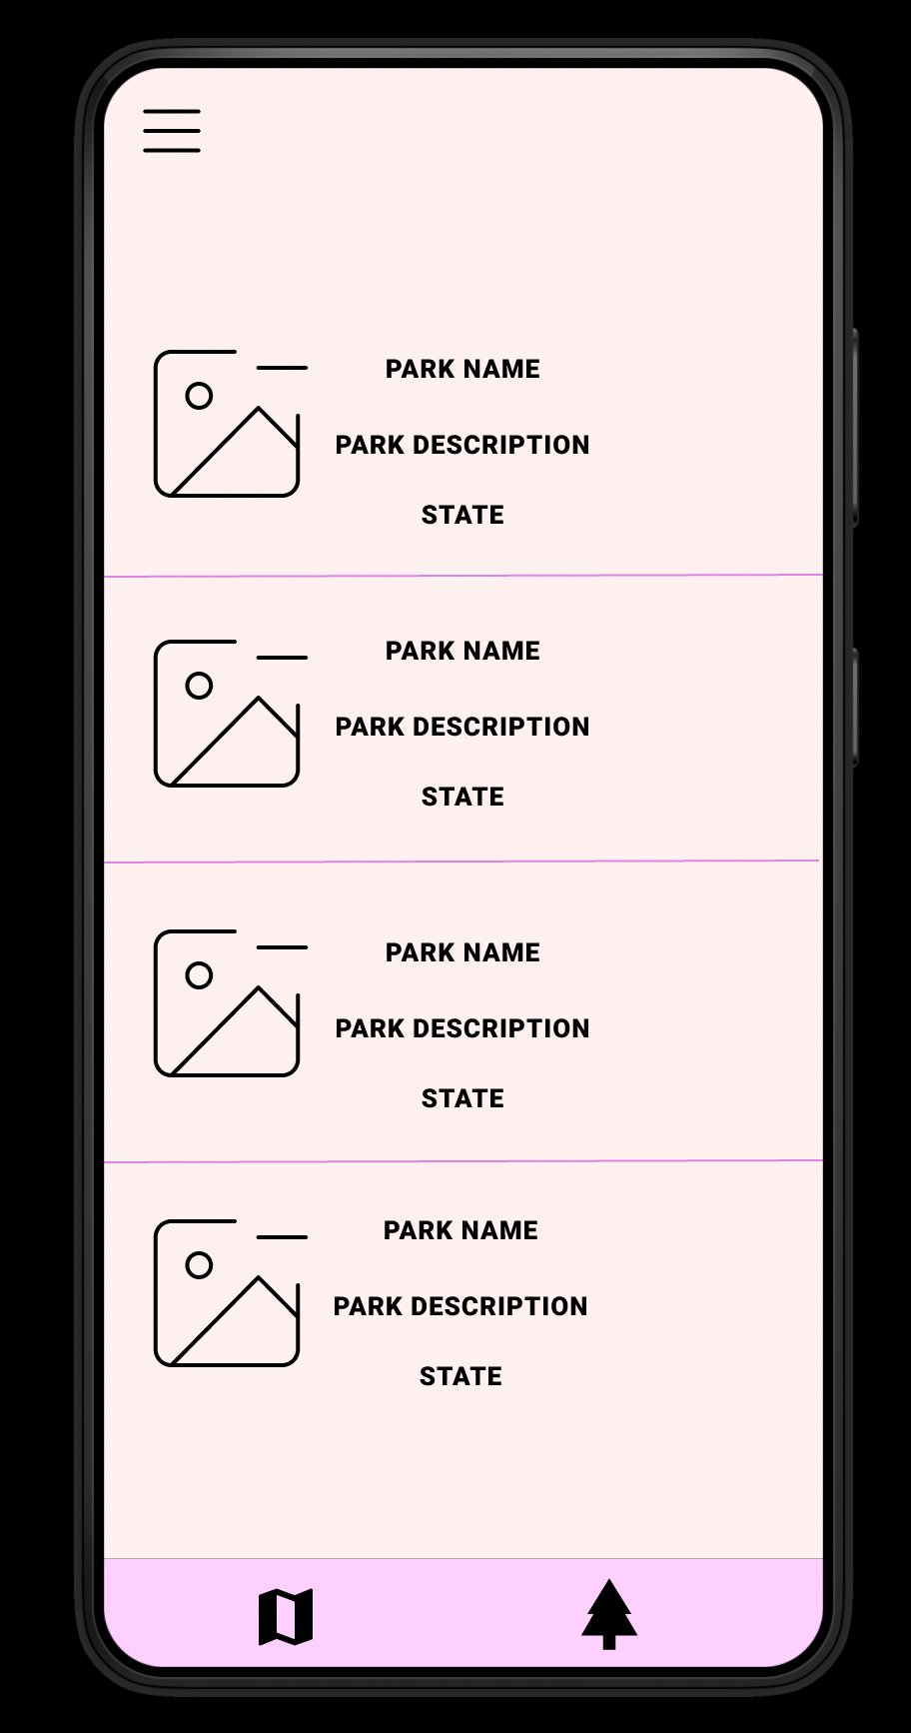
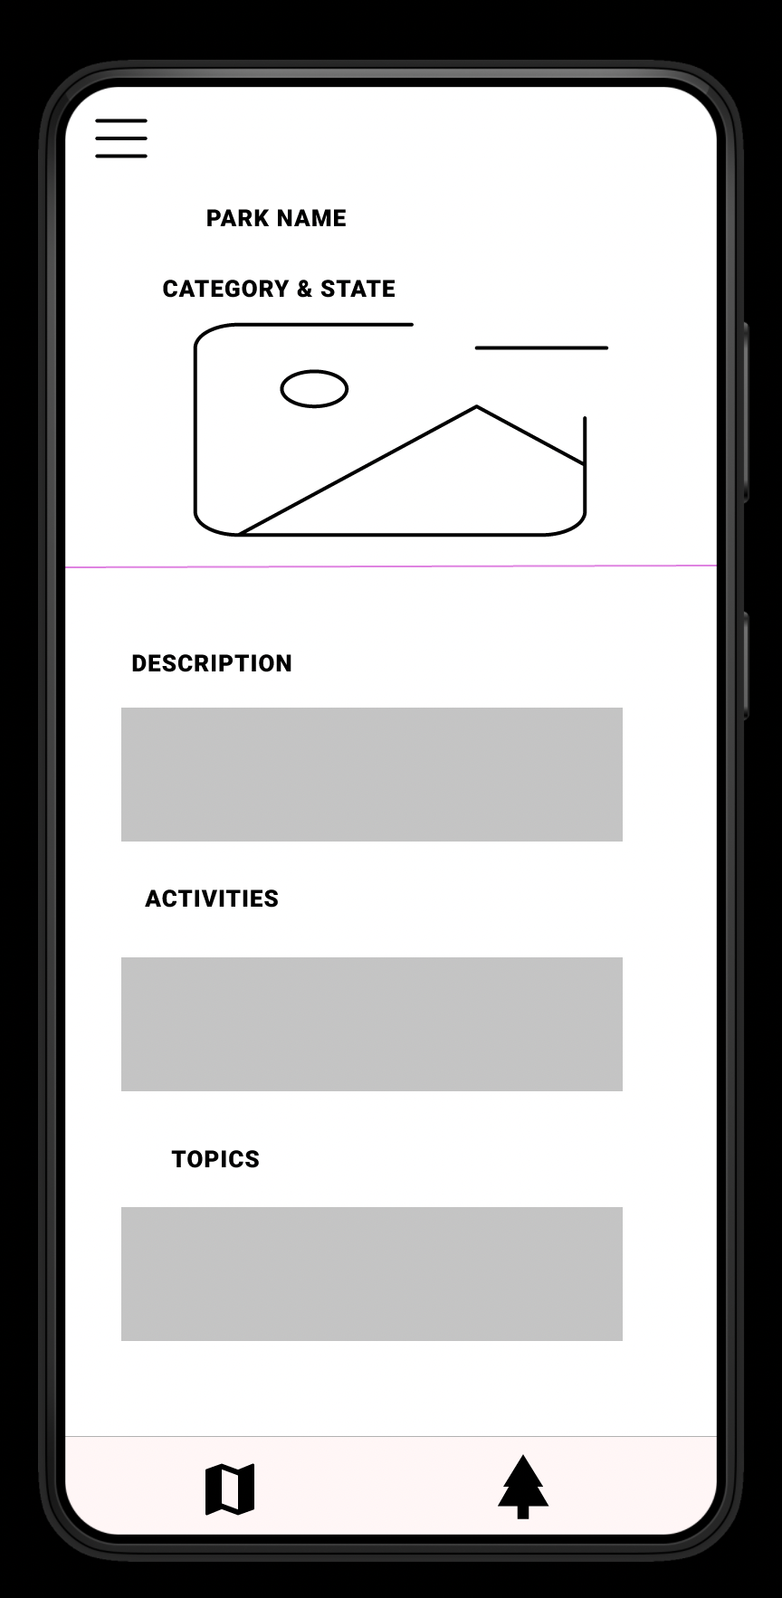
Extended screen of the Map with Tab Bar
Map Icon will show the map with the parks highlighted
Tree Icon will show an image, park name, park description and state
When user clicks on the park the wish to view the will go to another page with further information.

Slide 5
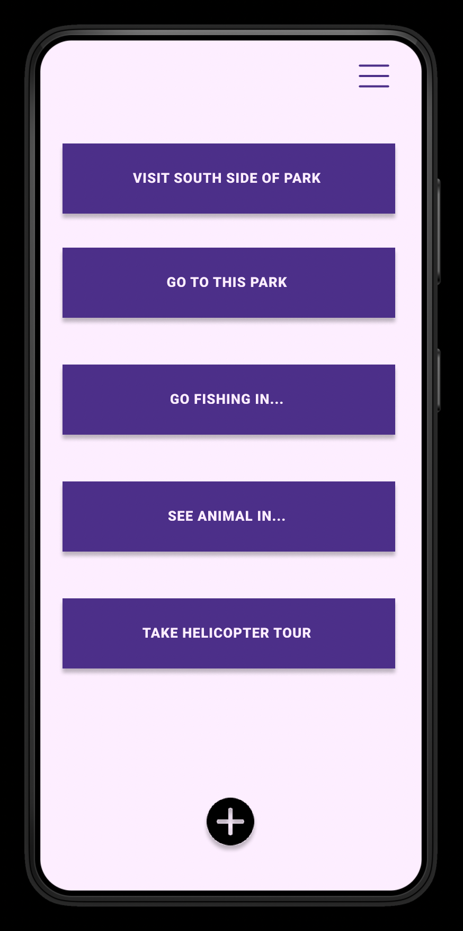
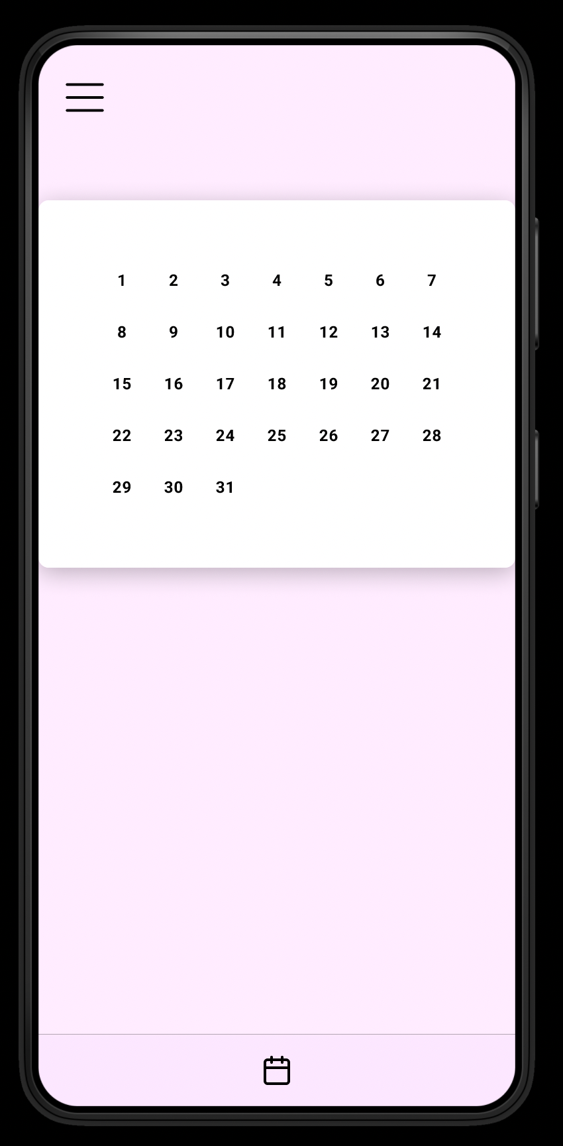
To-Do List with Calendar feature
User will be able to make a list of what activities they which to add in the park the want to visit and assign a date to them using the calendar.

Slide 6
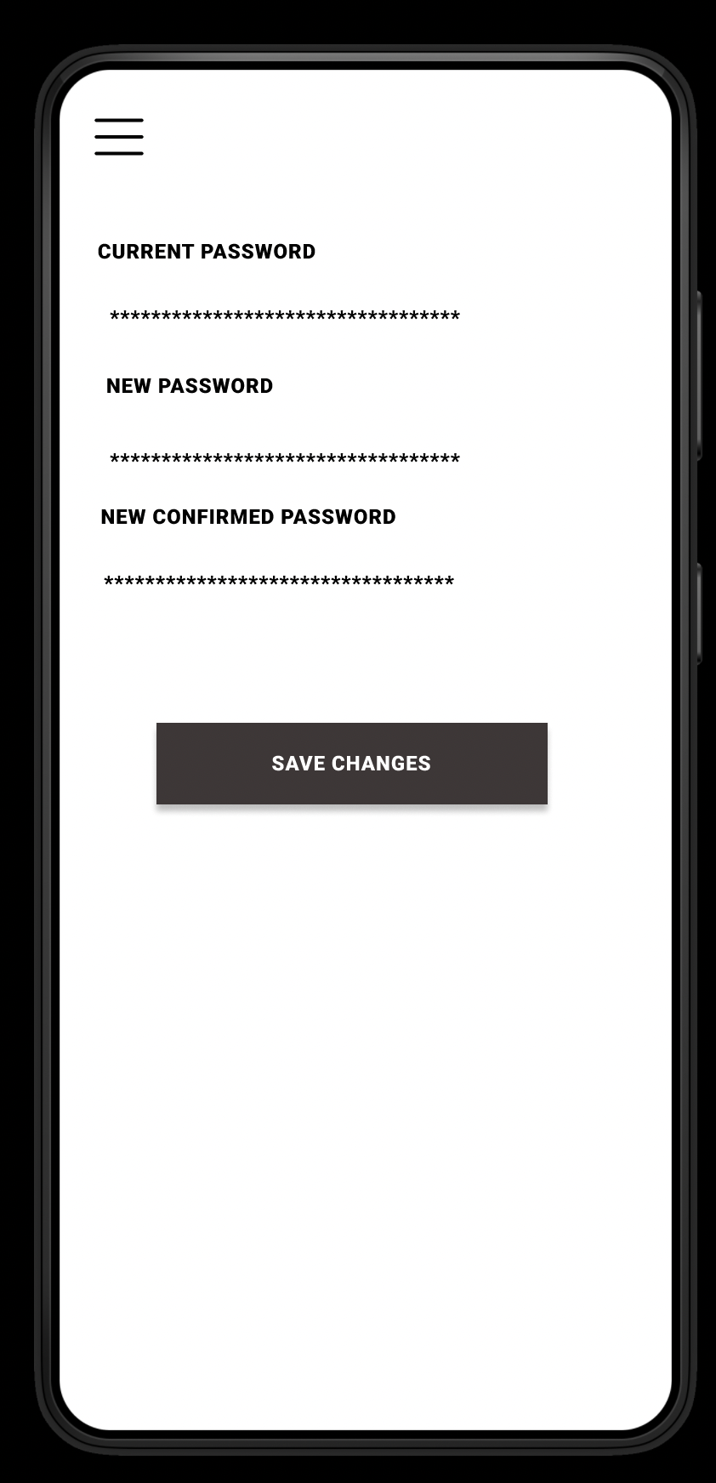
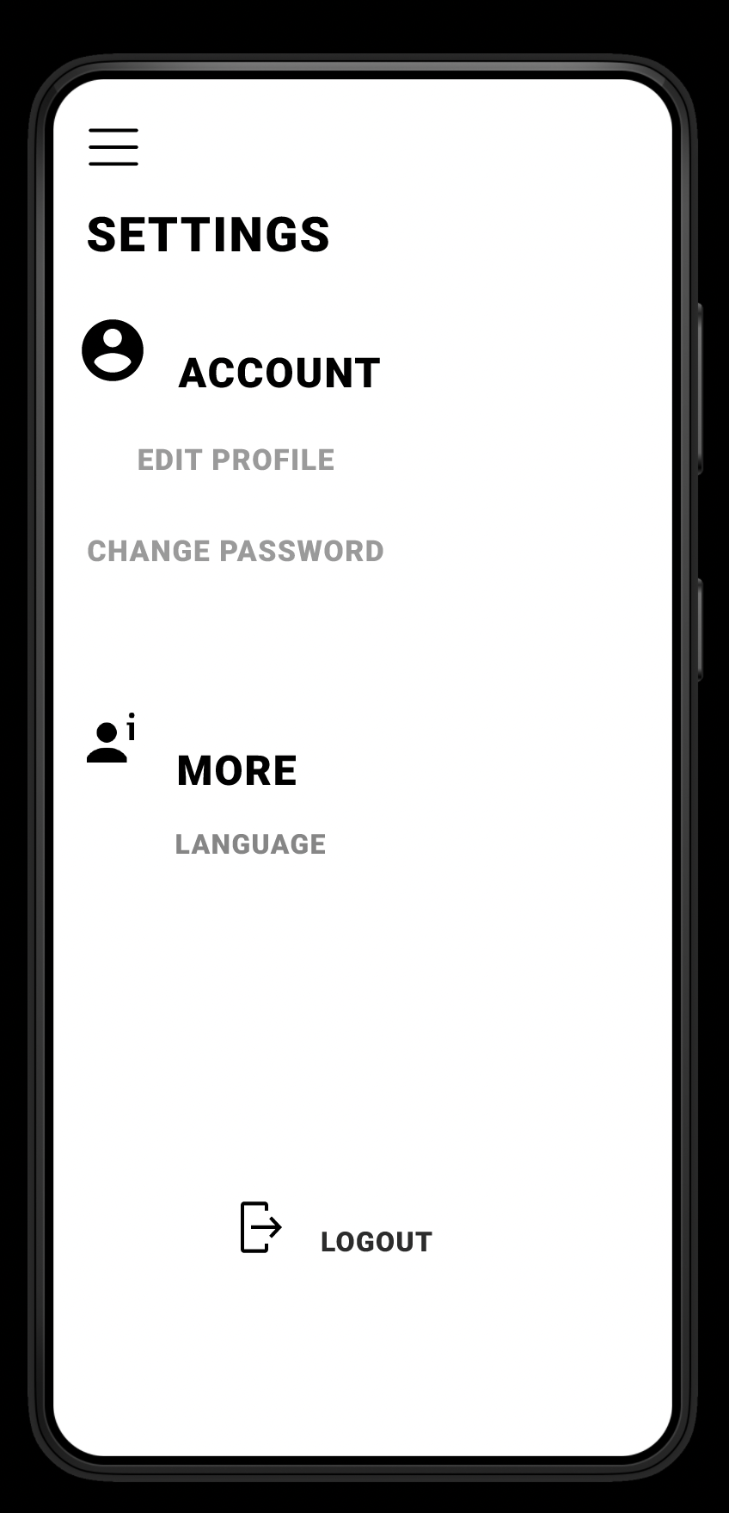
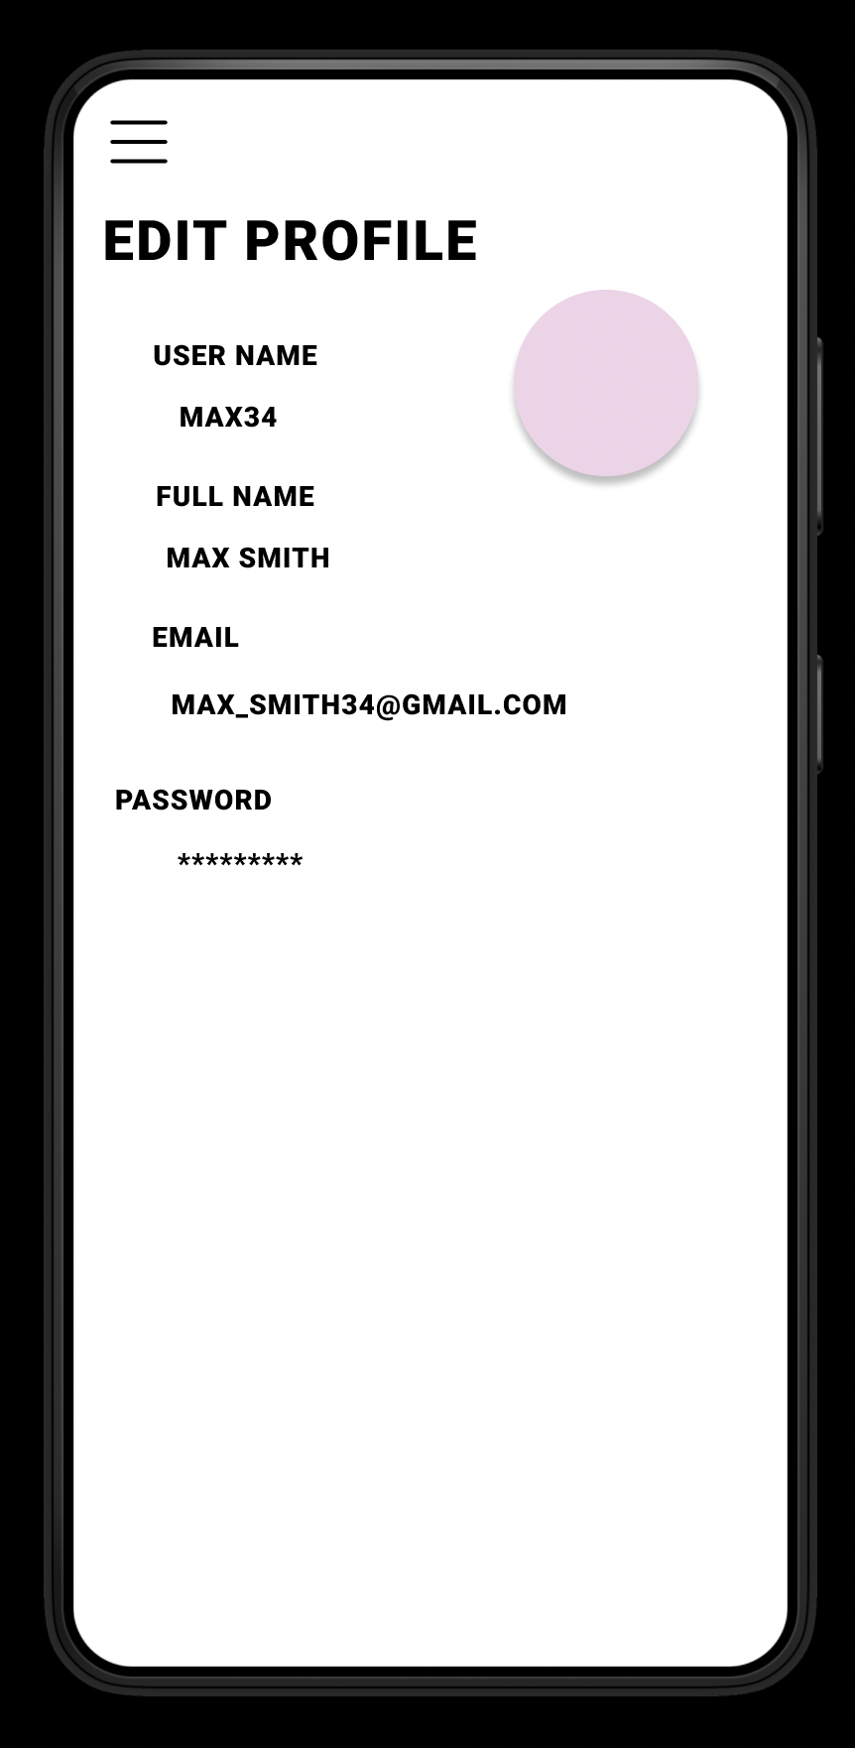
User Customization
Users will be able to change the language of the app and they will be able to edit their profile to a completely new one. Whether its their username, email, profile picture or password.

Slide 7
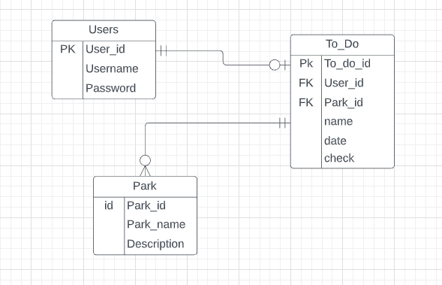
DataBase

Slide 8
Github Link
https://github.com/jojo0105/AppDev-FinalProject

